Slide 1
The Little Man Computer

Slide 2
The Little Man Computer
We will review the operations that the computer is capable of performing and look at how those operations work together to provide the computer with its power.
We will begin by introducing a model of the computer (the LMC); a model that operates in a very similar way to real computers but that is easier to understand.

Slide 3
The Little Man Computer
Using this model we will introduce:
a simplified, but typical, set of instructions that a computer can perform.
we will examine how these instructions are executed in the LMC
we will examine how these instructions are combined to form programs.

Slide 4
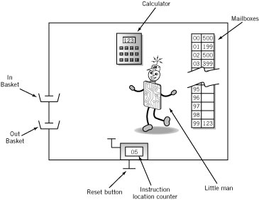
The Little Man Computer

Slide 5
Mailboxes: Address vs. Content
Addresses are consecutive
Content may be
Data or
Instructions
Address | Content

Slide 6
Mailboxes
At one end of the room, there are 100 mailboxes (memory) numbered 0 to 99, that can each contain a 3 digit instruction or data
The boss can place instructions in sequence in the mailboxes before the Little Man comes to work
The Little Man’s job is to read these instructions one by one and carry them out

Slide 7
Mailboxes: Content - Instructions
Op code
Operation code
Arbitrary mnemonic
Operand
Object to be manipulated
Data or
Address of data
Address | Content
 | Op code | Operand

Slide 8
Calculator
The calculator can be used to enter and temporarily hold numbers, and also to add and subtract.
The display on the calculator is three digits wide.
For this discussion there is no provision made for negative numbers, or for numbers larger than three digits.

Slide 9
Hand Counter
There is a two-digit hand counter, the type that you can click to increment the count.
The reset button for the hand counter is located outside the mailroom.
We will call the hand counter an instruction location counter. It is used to hold mailbox addresses.

Slide 10
In and Out Basket
The boss can set the counter at a starting address where the first of a sequence of instructions has been placed.
The boss can also place data for the Little Man in the In Basket.
The Little Man can be instructed to place data in the Out basket.
The boss can send data to the LMC by putting a slip of paper with a three- digit number on it into the basket, to be read by the LMC.
Similarly, the LMC can write a three-digit number on a slip of paper and leave it in the out basket, where it can be retrieved by the boss.
Other than setting the first address on the hand counter, the only interaction between the LMC and the outside environment are the In and Out Baskets

Slide 11
Little Man
Finally, there is the Little Man. His role is to repeatedly:
Read the mailbox address which appears in the counter
Retrieve the instruction from the mailbox address
Carry out the instruction
Click the hand counter button which increases its value by 1

Slide 12
The Little Man Computer

Slide 13
LMC – Instruction Set
We would like the LMC to do some useful work, so we define a small group of 3-digit instructions that he can perform.
Each instruction will consist of one digit which identifies which operation the LMC should perform – we will use the first of the three digits for this
This digit is called the operation code or op code
If the operation requires the LMC to use a particular mailbox we can use the other two digits to specify the mailbox address.

Slide 14
Instruction Set
Arithmetic | 1xx | ADD
 | 2xx | SUBTRACT
Data Movement | 3xx | STORE
 | 5xx | LOAD
Input/Output | 901 | INPUT
 | 902 | OUTPUT
Machine Control (coffee break) | 000 | STOP

Slide 15
Input/Output
Move data between calculator and in/out baskets
 |  | Content
 |  | Op Code | Operand (address)
INP (input) |  | 9 | 01
OUT (output) |  | 9 | 02
Notes:
Note that the input and output instructions do not use any mailboxes during execution, since the procedure for each only involves transfer of data between an in or out basket and the calculator.

Slide 16
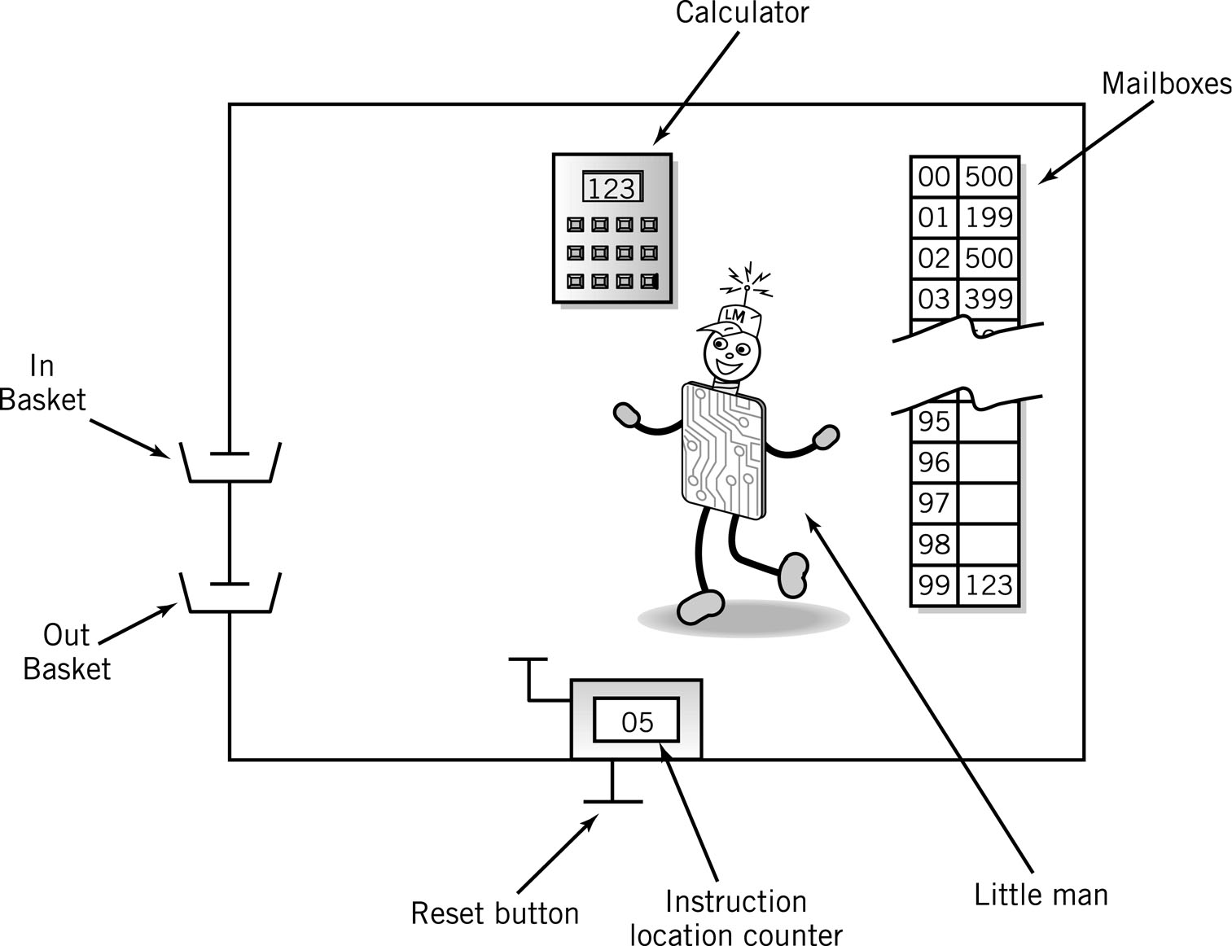
LMC Input/Output
INP
OUT

Slide 17
Internal Data Movement
Between mailbox and calculator
 |  | Content
 |  | Op Code | Operand (address)
STA (store) |  | 3 | xx
LDA (load) |  | 5 | xx

Slide 18
LMC Internal Data
LDA
STA

Slide 19
Arithmetic Instructions
Perform operation in the calculator
 |  | Content
 |  | Op Code | Operand (address)
ADD |  | 1 | xx
SUB |  | 2 | xx

Slide 20
LMC Arithmetic Instructions
ADD
SUB

Slide 21
Simple Program: Add 2 Numbers
The logic for adding two numbers in the LMC is given on the right. Write out the series of LMC instructions that implements this logic.
Assume data is stored in mailboxes with addresses >90
Input a #
Store the #
Input a #
Add
Output the
number

Slide 22
Program to Add 2 Numbers
Mailbox | Code | Instruction Description
00 | 901 | ;input 1st Number
01 | 399 | ;store data
02 | 901 | ;input 2nd Number
03 | 199 | ;add 1st # to 2nd #
04 | 902 | ;output result
05 | 000 | ;stop

Slide 23
Assembler
The first computers were all programmed with numeric codes
Binary numbers were used instead of the decimal numbers used in the LMC model
This can be tedious and error-prone
Assembler programs were developed to simplify the job of writing code

Slide 24
Assembler
A mnemonic code is created for each instruction
A programmer writes the program in assembly language using these mnemonics
This is much easier as the mnemonics are easy to remember
The assembly language program is fed into the assembler
The assembler reads the program and produces the machine code as output

Slide 25
Assembler Advantages
Programs can be written much more quickly when written in assembler
Programs written in assembler are much easier to understand and debug
“Directives” can be used in the assembler such as “DAT” which tells the compiler to reserve a space in memory to be used for data DAT can also tell the assembler to put a constant into that memory address

Slide 26
Assembler advantages
Most assembly languages allow the use of labels.
A label is simply a word that is used to either name a memory address where an instruction or data is stored, or to refer to that address in an instruction.
When a program is assembled.
A label to the left of an instruction mnemonic is converted to the memory address the instruction or data is stored at.
A label to the right of an instruction mnemonic takes on the value of the memory address referred to above.

Slide 27
Program to Add 2 Numbers: Using Mnemonics
Mailbox | Mnemonic | Instruction Description
00 | INP | ;input 1st Number
01 | STA 99 | ;store data
02 | INP | ;input 2nd Number
03 | ADD 99 | ;add 1st # to 2nd #
04 | OUT | ;output result
05 | HLT | ;stop

Slide 28
Program to Add 2 Numbers: Using Mnemonics and Labels
Mailbox | Mnemonic | Instruction Description
00 | INP | ;input 1st Number
01 | STA NUM1 | ;store data in memory labelled NUM1
02 | INP | ;input 2nd Number
03 | ADD NUM1 | ;add 1st # to 2nd #
04 | OUT | ;output result
05 | HLT | ;stop
DAT | NUM1 | Labelled data area called NUM1

Slide 29
Assembler advantages
Labels make writing in assembler much easier as the assembler keeps track of the actual memory address
If you insert extra code in a program and therefore cause subsequent instructions and data to be moved to a different address, without labels you would have to adjust any memory references accordingly
With labels, the assembler will automatically re-calculated all labeled addresses when the program is re-assembled.

Slide 30
An Extended Instruction Set
The instruction set we have specified does not provide any means for branching or looping, both of which are very important constructs for programming.
We need to extend the instruction set to provide the LMC to carry out more complex programs.

Slide 31
Program Control
Branching
executing an instruction out of sequence
Changes the address in the counter
Halt
Stops the work
 |  | Content
 |  | Op Code | Operand (address)
BR (Jump) |  | 6 | xx
BRZ (Branch on Calc=0) |  | 7 | xx
BRP (Branch on Calc=+) |  | 8 | xx
HLT (stop) |  | 0 | (ignore)

Slide 32
Program control
While value = 0 Do
Task;
NextStatement
45 | LDA 90 | 590 | 90 is assumed to contain value
46 | BRZ 48 | 748 | Branch if the value is zero
47 | BR 60 | 660 | Exit loop; jump to NextStatement
48 | .
 | .
 | .
59 | BR 45 | 645 | End of Task; loop to test again
60 |  |  | Next statement
Notes:
These three new instructions make it possible to break from the normal sequential processing of instructions.

Slide 33
Extended Instruction Set + Mnemonics
Arithmetic | 1xx | ADD
 | 2xx | SUB
Data Movement | 3xx | STORE (Calc Data to Mailbox)
 | 5xx | LOAD (Mailbox Data to Calc)
BR | 6xx | JUMP
BRZ | 7xx | BRANCH ON 0
BRP | 8xx | BRANCH ON +
Input/Output | 901 | INPUT
 | 902 | OUTPUT
Machine Control (coffee break) | 000 | HALT HLT

Slide 34
Find Positive Difference of 2 Numbers
00 | INP | 901
01 | STA 10 | 310
02 | INP | 901
03 | STA 11 | 311
04 | SUB 10 | 210
05 | BRP 08 | 808 | ;test
06 | LDA 10 | 510 | ;if negative, reverse order
07 | SUB 11 | 211
08 | OUT | 902 | ;print result and
09 | HLT | 000 | ;stop
10 | DAT | 000 | ;used for data
11 | DAT | 000 | ;used for data

Slide 35
Find Positive Difference of 2 Numbers Using Labels
00 | INP | 901
01 | STA FIRST | 310
02 | INP | 901
03 | STA SECOND | 311
04 | SUB FIRST | 210
05 | BRP OUTPUT | 808 | ;test
06 | LDA FIRST | 510 | ;if negative, reverse order
07 | SUB SECOND | 211
08 | OUTPUT OUT | 902 | ;print result and
09 | HLT | 000 | ;stop
10 | FIRST DAT | 000 | ;used for data
11 | SECOND DAT | 000 | ;used for data

Slide 36
Instruction Cycle
Fetch: Little Man finds out what instruction he is to execute
Execute: Little Man performs the work.

Slide 37
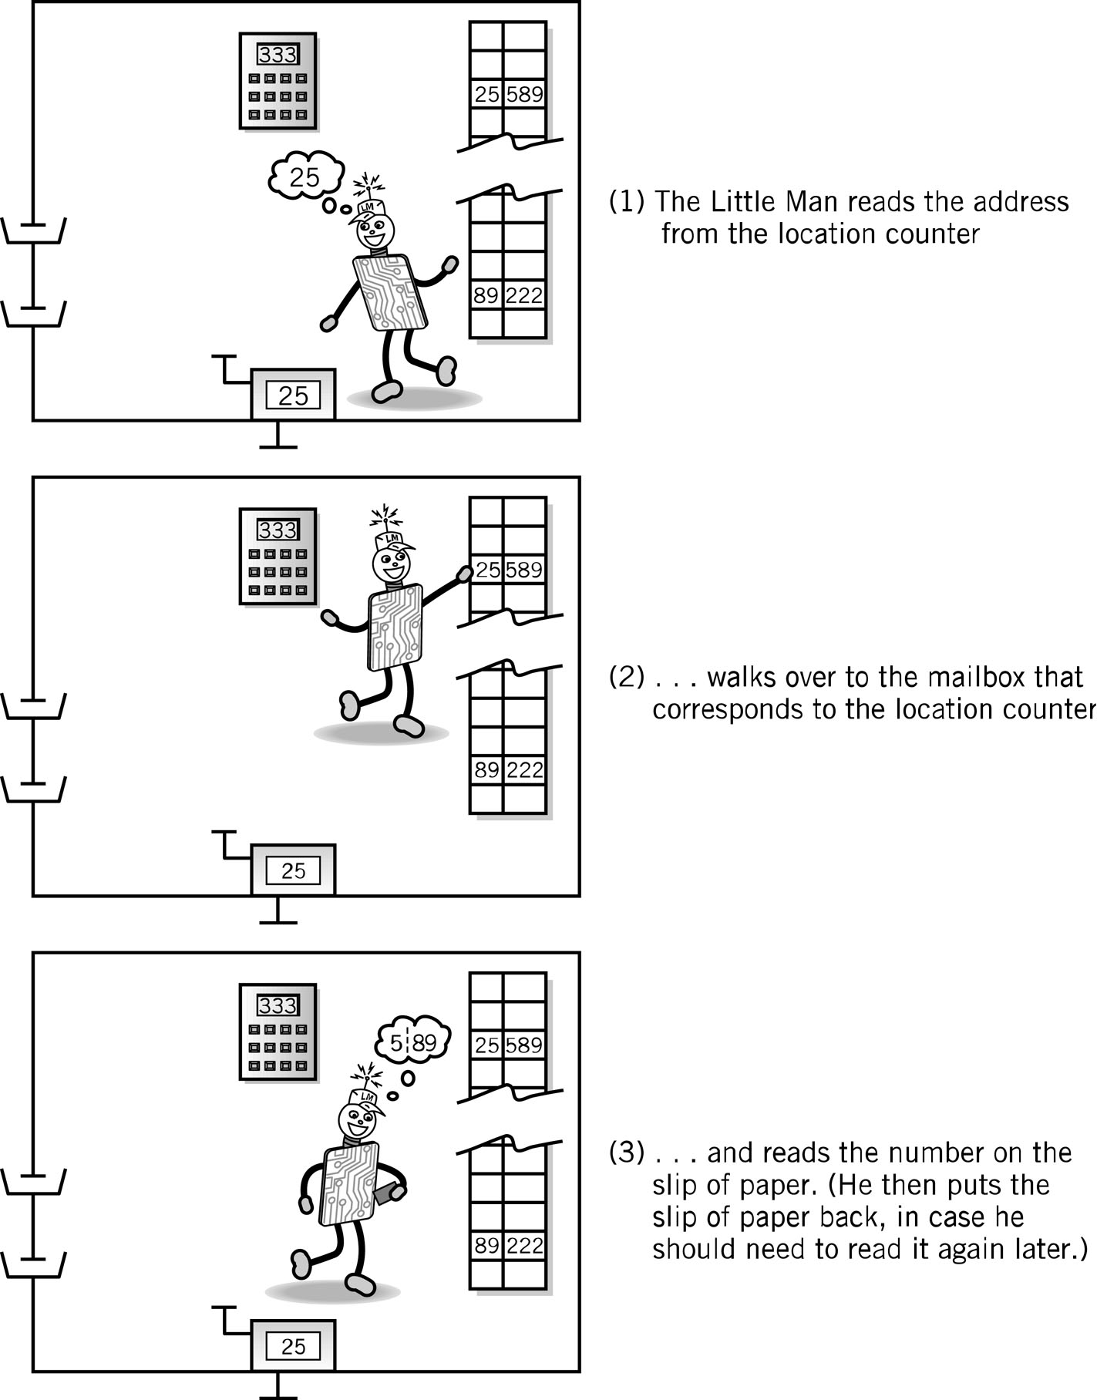
Fetch Portion of Fetch and Execute Cycle
1. Little Man reads the address from the location counter
2. He walks over to the mailbox that corresponds to the location counter

Slide 38
Fetch, cont.
3. And reads the number on the slip of paper (he puts the slip back in case he needs to read it again later)

Slide 39
Execute Portion
The execution portion of each instruction is, of course, different for each instruction.
However, even here, there are many similarities.
The load instruction (LDA) is typical.

Slide 40
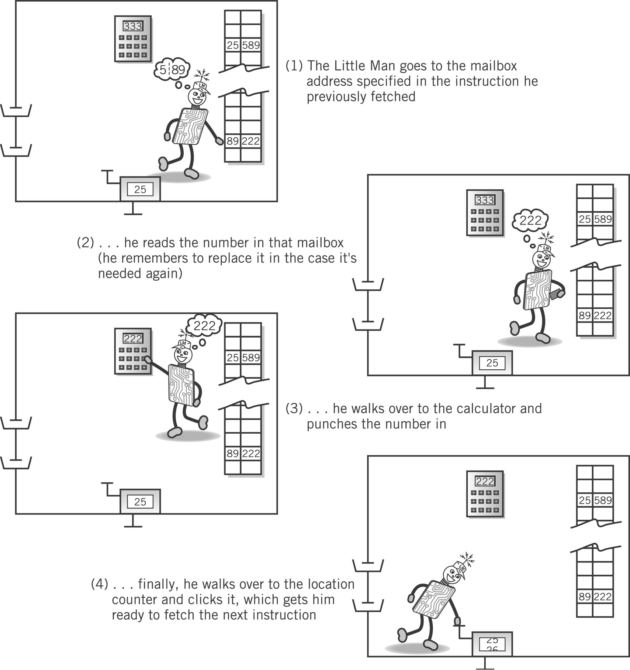
Execute Portion (LDA)
1. The Little Man goes to the mailbox address specified in the instruction he just fetched.
2. He reads the number in that mailbox (he remembers to replace it in case he needs it later).

Slide 41
Execute, cont.
3. He walks over to the calculator and punches the number in.
4. He walks over to the location counter and clicks it, which gets him ready to fetch the next instruction.

Slide 42
von Neumann Architecture (1945)
John Von Neumann is usually considered to be the developer of modern computer architecture.
The major guidelines that define a Von Neumann architecture are:
Stored program concept - memory holds both programs and data.
Memory is addressed linearly – i.e address consists of a single number
Memory is addressed without regard to content (instruction or data)

Slide 43
Von Neumann Architecture (1945)
Instructions are executed sequentially unless an instruction or an outside event cause a branch to occur.

Slide 44
Von Neumann Architecture
John Von Neumann defined the functional organisation of the computer to be made up of:
A control unit that executes instructions
An arithmetic logic unit that performs arithmetic and logical calculations,
Memory

Slide 46
LMC & von Neumann
If you check over the guidelines and organization just described, you will observe that the LMC is an example of a von Neumann architecture :)

Slide 47
LMC & von Neumann
LMC is an example of a von Neumann architecture
The Little Man carries out the functions of the control unit fetching, interpreting and carrying out instructions from memory one-at-a-time
The Little Man also moves the data around which is the function of the communication bus
Registers are electronic storage internal to the central processing unit and are much faster than main memory storage
The LMC has 4 registers, the in-tray, the out-tray the counter and an accumulator register (in calculator)
The mail boxes act as main memory, containers for instructions and also for data

Slide 48
LMC & von Neumann
The counter acts as a program counter which holds the address of the next instruction to be executed
The calculator acts as the arithmetic and logical unit which can carry out the actual processing of the data
The calculator also has the accumulator register which it uses to hold the value of the last calculation as well as one operand of an operation (e.g. add)

Slide 49
Summary
The LMC provides a model of the workings of a computer.
The LMC works by following simple instructions, which are described by numbers.
Some of these instructions cause the LMC to change the order in which instructions are executed.
Both data and instructions are stored in individual mail slots. There is no differentiation between the two except in the context of the particular operation taking place.
The LMC follows the fetch-execute cycle.
Normally the LMC executes instructions sequentially from the mail slots except when he encounters a branching instruction.
An assembler makes program development and maintenance much easier

